Slide 1
Sustainable Energy for All (SEFORALL)
Zambia Action Agenda & Investment Plan
Chipampa Chola
Energy Officer
Ministry of Energy
Global Conference on Scaling-up Energy Access and Finance in Least Developed Countries
Beijing, China
30-31 May, 2019

Slide 2
Outline
Country Context
Renewable Energy Context
Overview of Electricity Sector
SE4ALL AA Targets
Policy Framework & Linkages
Summary of IP pipeline of projects
Key Take-Aways

Slide 3
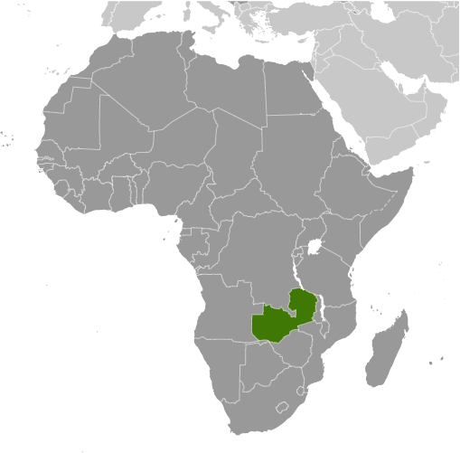
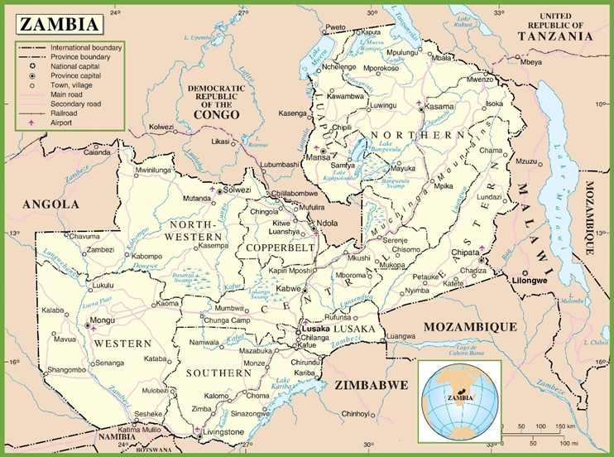
Country Context
Location | Southern Africa
Total surface area | 752,614 Km²
Population (2016) | 17.9 million
Population Density | 23/km²
Urban Population | 40%
GDP/capita | US$ 1,178.39
Main Economic Sectors | Copper mining Construction Agriculture

Slide 4
Overview of Electricity Sector
Generation
Consumption
Access
2,878 MW
Total installed capacity
83%
of large hydro
31.2%
National
67.7%
Urban
Installed Capacity by source
4.4%
Over 50% electricity is consumed by mining sector
Household sector accounts for 30%
Rural
5%
Annual Demand Growth

Slide 5
Renewable Energy Context
Solar
Geothermal
Mini-hydro
Biomass
Wind
6-8hrs/day, energy output of 5.5kwh/m²/day
Solar resource measurement completed in 2017
Targeting on-grid 200 MW – Get Fit (supported by REFIT Strategy) and 600 MW - Scaling Solar Program
Average speed 7 - 8.2 m/s at 80 meter height
2 year wind resource assessment completed in December 2018
80 hot springs available in Zambia
Studies by one IPP shows 15MW to 90MW potential In Southern Province (Lochniver Park)
Installed capacity of 39.55 MW
Potential of additional 38.6 MW
0.64 MW under construction by REA
Study done by IRENA in 2013 indicates 500 MW potential
Biomass and Food Security Assessment underway

Slide 6
Action Agenda

Slide 7
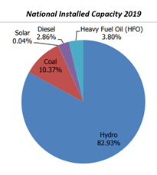
Action Agenda 2030 Targets
Renewable Energy
Objective: To increase access to modern energy services for rural and peri-urban households
Scope: RE off-grid/mini-grids including solar home systems
Outcomes/Benefits
Boost productive uses of electricity
Improve health outcomes
Rationale
Only 4.4% rural electricity access
Need to intensify off-grid electrification
Objective: Promote Renewable Energy, Diversify energy mix and promote private investment
Scope
Policy and regulatory framework for renewables
Project development for wind, mini hydro, geothermal and solar
Outcomes/Benefits
Stable and reliable baseload power / diversification from (climate sensitive) large hydro
Improved quality and reliability of electricity provision for 4.5 million on-grid customers
Rationale
Availability of solar/wind resource measurement
Strong private sector interest

Slide 8
Action Agenda 2030 Targets cont..
Objective: Objective: decrease in energy intensity of 2.4% per year
Scope:
Policy and standards development
installation of power factor correction equipment for medium and large customers
Installation of advanced meters for ZESCO medium and large customers
Outcomes/Benefits
Huge distribution and transmission savings
Rationale: Study on power factor correction show huge energy savings
Objective: To increase access to modern and Clean Energy Cooking Solutions
Scope: clean cooking solutions (such as LPG, Electricity, biogas & improved cooked stoves)
Outcomes/Benefits
Improve health outcomes
Increased Productivity
Rationale: Low access to Clean Cooking Systems

Slide 9
Policy Framework & Linkages
Country’s development blueprint – Vision 2030, and the Seventh National Development Plan (7NDP)
IP will be implemented over two cycles: the first one being from 2019 – 2025 and the second one from 2026 -2030
The first cycle will stretch slightly over five years and overlap with the remainder of the 7th National Development Plan, 2017 -2021.
2008 National Energy Policy
2008 Rural Electrification Master Plan (REMP): 100% access in urban areas and 50.6% access to electricity in rural areas by 2030
2015 Nationally Determined Contributions

Slide 10
Investment Prospectus
Pipeline Projects 2019-2025

Slide 11
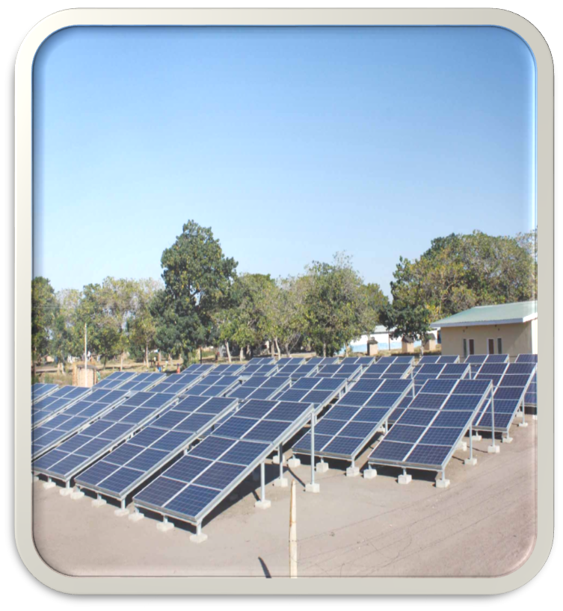
Scaling-up access to electricity
Project 1
Solar Home Systems Energize Zambia –Private Sector
Target - 50,000 SHS installation
Total Investment (USD) – $2,500,000
Financing Gap - $900,000
Developer – Private Sector
Project 2
Pay As You Go Solar Home Systems
Target - 100,000 Solar Home Systems (SHS)
Total Investment (USD) – 2,300,000
Financing Gap – 2,000,000
Developer – Private Sector
)
Project 3
Rural electrification projects to scale up electricity access –
Target - SHS installation
Total Investment (USD) – $13,226,550
Financing Gap - $13,226,550
Developer – PPP (Rural Electrification Authority)

Slide 12
Access to Modern and Clean Energy Cooking Solutions
Project 1
Scaling biogas installations
Target - 3,500 4m2 domestic digesters by 2025
Total Investment (USD) – $3,545,500
Financing Gap - $3,545,500
Developer – Public Private Partnership
Project 3
Modern clean cooking solutions
Target - 100,000 stoves by 2025,
10,000 tons of wood pellets per year.
200,000 tons per year by 2025.
Total Investment (USD) – $36,000,000
Financing Gap - $12,000,000
Developer – Private
Project 2
Integrated clean cooking project
Target - Deploy 800,000 ICS, 100 LPG distribution and storage centers by 2024
Total Investment (USD) – $9,400,000
Financing Gap - $9,400,000
Developer – Public Private Partnership

Slide 13
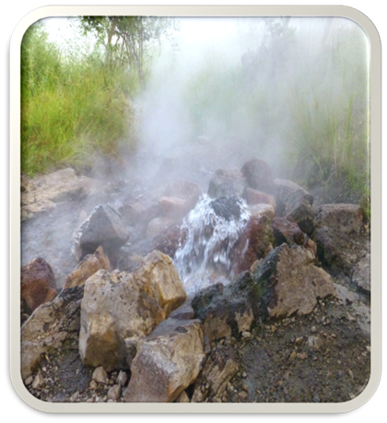
Developing and Diversifying the Contribution of Renewable Energy
Project 1
Alternative Renewable Energy Programme (AREP)
Target - 400MW (solar and wind) by 2022
Total Investment (USD) – $600,000,000
Financing Gap - $570,000,000
Developer – Public Private Partnership (IDC)
Project 3
Bwengwa River Geothermal Project
Target - 48,881MWh per annum over 20 years (Geothermal)
Total Investment (USD) – 60,000,000
Financing Gap - $53,760,000
Developer – Private
Project 2
Increased Access to Electricity and Renewable Energy Production
Target - 20MW (mini grid and off-grid solutions)
Total Investment (USD) – 165,316,200
Financing Gap - $136,616,200
Developer – Public Private Partnership

Slide 14
Developing and Diversifying the Contribution of Renewable Energy
Project 4
Mumbwa Solar PV Project
Target - 100MWp on-grid Solar PV plant (50,000 HH)
Total Investment (USD) – $110,000,000
Financing Gap - $83,600,000
Developer – Private
Project 6
Feasibility, construction and commissioning of mini hydro projects
Target - 20MW Small Hydro Projects
Total Investment (USD) – 61,819,000
Financing Gap - $61,819,000
Developer – Public Private Partnership (ZESCO)
Project 5
Upscaling of small hydropower & mini grid development
Target – 16.8MW Small Hydro Projects
Total Investment (USD) – $54,316,000
Financing Gap - $54,316,000
Developer – Public Private Partnership (ZESCO)
Project 7
Global Energy Transfer Feed-in Tariffs (GET FIT) Programme – (Phase I and II)
Target - 200MW over 3 years (up to 20MW/RE project)
Total Investment (USD) – 245,490,000
Financing Gap - $~ 56,190,000
Developer – Local and international private sector IPPs

Slide 15
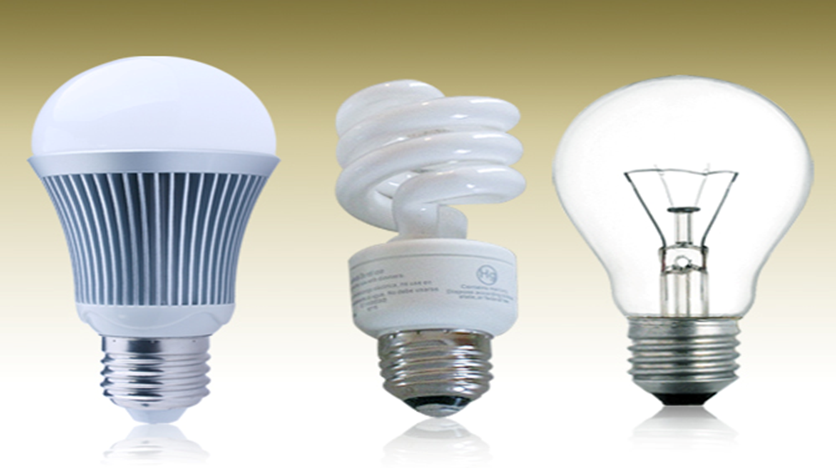
Energy Efficiency
Project 1
Power Factor Correction Programme – Phase I
Target – 5,000 customers,
194,331MWh/year distribution savings. 2,596MWh/year transmission savings
Total Investment (USD) – $38,000,000
Financing Gap - $38,000,000
Developer – Public Private Partnership
Project 2
Installation of Advanced Metering Infrastructure Platform
Target - 10,000 metres
Total Investment (USD) – 12,500,000
Financing Gap - $12,500,000
Developer – Public Private Partnership

Slide 16
Key Take-Aways
Zambia’s Investment Prospectus draws on the many on-going activities in the energy sector
Successful implementation of investment pipeline will require close collaboration with Cooperating Partners (and the private sector) for financial and technical Support
It is envisioned that the IP will achieve the following;
the development of bankable and viable projects,
mobilization of resources
provide an opportunity for increased private sector participation in the quest to deliver sustainable energy to all Zambians.

Slide 17
Thank You For Your Attention

