Slide 1
In the context of the
SUSTAINABLE ENERGY FORUM FOR EAST AFRICA
SEforALL Action Agendas and Investment Prospectuses in East Africa
Ms. Ilka Neyla Buss- SEforALL Africa Hub
Kigali, March 19th, 2018

Slide 2
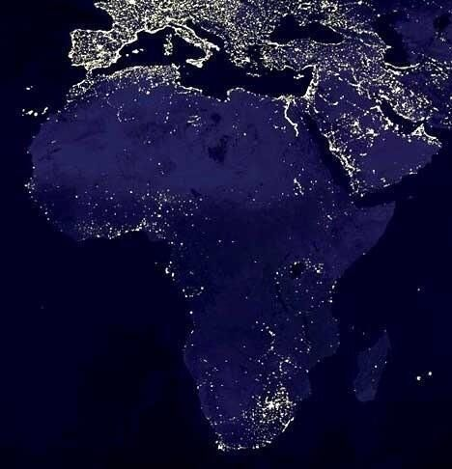
Africa’s Energy Need
Over 645 million Africans live without access to electricity – the bulk live in Sub-Saharan Africa
Energy sector bottlenecks cost the continent 2-4 % GDP annually
The continent cannot develop in the dark

Slide 3
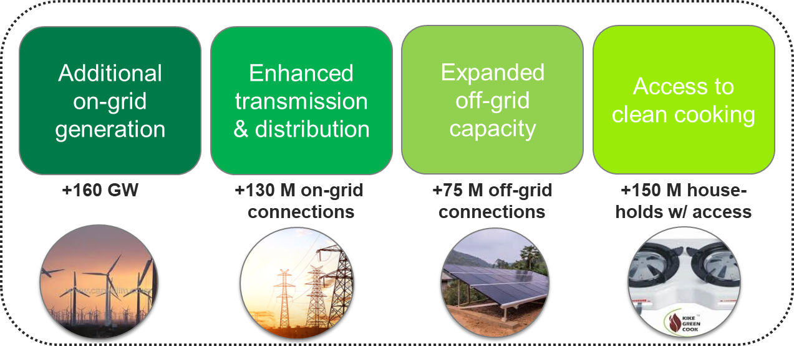
The New Deal on Energy for Africa
Lighting up and powering Africa is the first of the Bank’s High-5 priorities
The Bank has launched New Deal on Energy for Africa (NDEA) to achieve universal access by 2025, which will require connecting over 200 Mio households and nearly doubling grid generation capacity
The Bank’s lending in support of energy projects: reached almost USD 1.4 billion in 2017 and is expected to reach USD 2.4 billion in 2018
The Bank has pledged to commit US$ 12 billion by 2020 of its own resources to leverage another US$ 45 – 50 billion

Slide 4
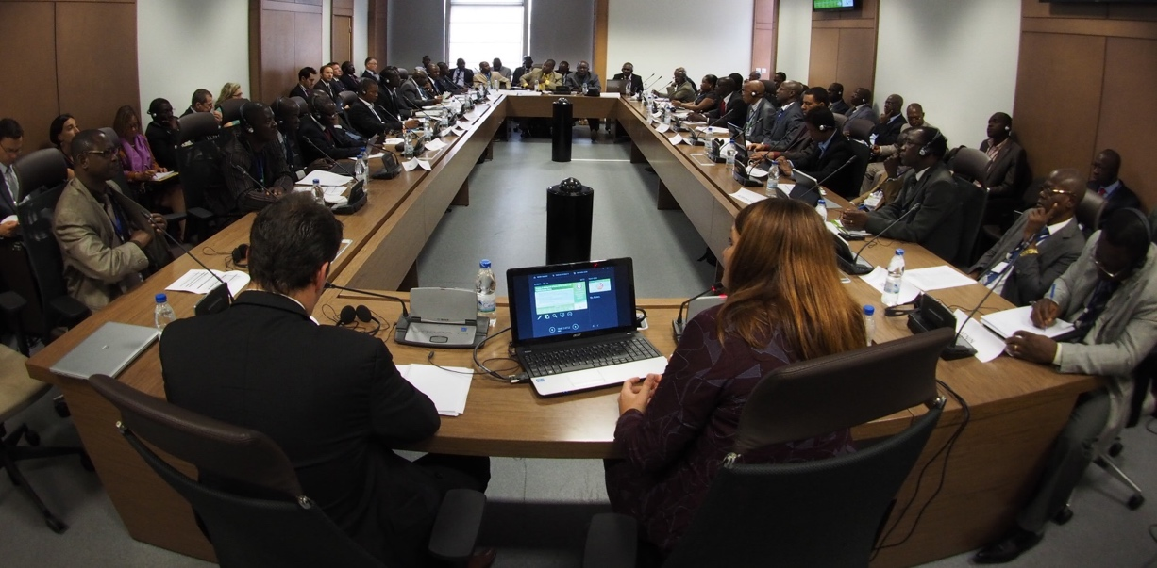
The SEforALL Africa Hub
Policy and Guidance
Technical Assistance
Designing the SEforALL country action process, mainstreaming a coordinated approach, providing a template and guidelines for the SEforALL Action Agenda and Investment Prospectus, for the consultative processes and promoting quality control.
Providing technical assis-tance to African countries and energy stakeholders to achieve SEforALL objectives related to energy access, energy efficiency and renewable energy. The TA is mainly delivered through the GEF-funded African Climate Technology Center project.
Knowledge Management
Workshops & Events
The Hub collects information on the implementation of the SEforAll initiative in Africa and make it available on its website: www.se4all-Africa.org
Organises different events to promote the implementation of the SEforAll in Africa and showcase the progress of SEforALL in the continent.
“The most active Regional Hub is Africa […] could serve as a model for the others”
(SEforALL Strategic Framework for Results 2016-21)

Slide 5
Hub Members and Partners
Members
Permanent Members of the Hub’s Oversight Committee:
Rotating members of the Hub:
Partners
RE Marketplace & AA
SEforALL Implementation
Monitoring Methodologies
Coordination in ECOWAS countries
Partnership on IP
CCS Programs
Bioenergy training
Mapping of Energy Initiatives
Country Actions
Energy Practitioners Network
Mini-Grid Programme

Slide 6
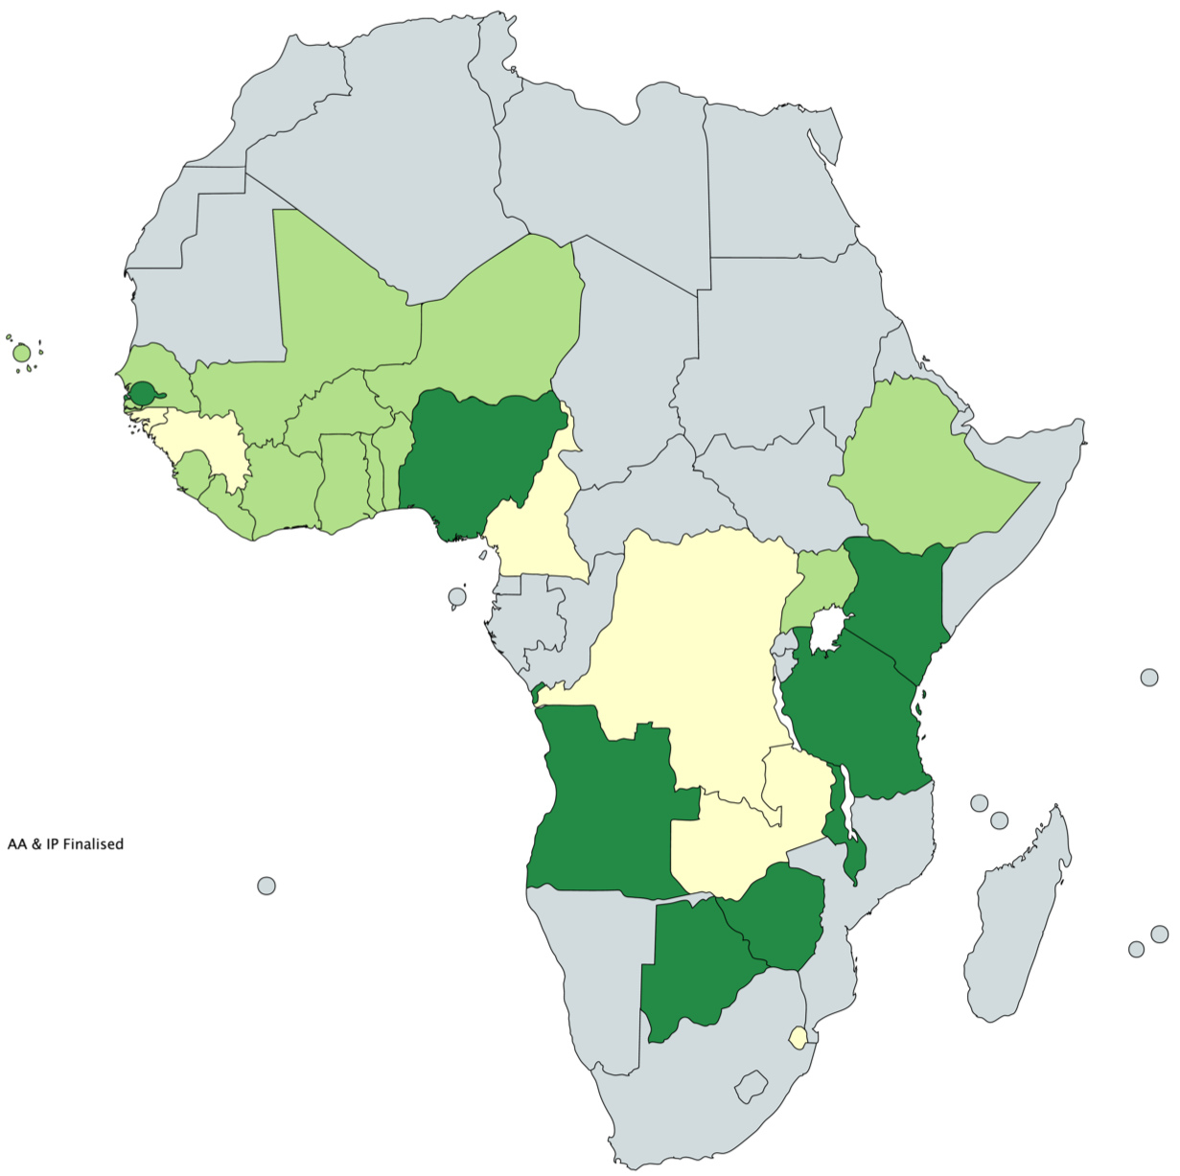
Status of AA & IP Development in Africa
With the support of the SEforALL Africa Hub and/or ECREEE the following has been achieved:
20
AA Completed
5
AA Under Development
AA & IP Finalised
AA Finalised
8
IP Completed
AA Under Development
IP Under Development
Download Links:
18
IP Under Development
SE4ALL Country Data:
Here
ECREE Country Data:
Here
Notes:
https://www.se4all-africa.org/se4all-in-africa/country-data/
https://mapchart.net/africa.html

Slide 7
Status of SEforALL Process in EAC Countries
Kenya and Tanzania have completed both AA and first IP iteration
Rwanda and Uganda both have completed AAs and are currently developing their first IP iteration
Burundi and South Sudan have undergone a RAGA but have not engaged in AA&IP development
National SEforALL Secretariats
The SEforALL Africa Hub supported the establishment of the first two (2) National SEforALL Secretariats in Tanzania and Kenya. Main Mandate:
Overall coordination, development, implementation and monitoring of the SE4ALL activities in the country
Mobilization of resources for implementation for fast-tracking of priority projects identified under the AA/IP

Slide 8
2018-21 Outlook and Focus of SEforALL Africa Hub
Implementing the SEforALL objectives at country-level presents many challenges, notably in terms of institutional capacity, coordination, monitoring, and financing. Going forward, SEforALL will focus on the execution of the following actions in order to maximize its impact:
Key Priority Areas
IP Improvement
National SEforALL Secretariats
Mobilization of Financing
The Hub will work on improving the bankability of IPs and on establishing processes to ensure constant IP updating. We are working with SEforALL Global and Power Africa to systematically improve existing IPs, develop new IPs based on the new standard and create opportunities to match IP projects with financing.
The Hub will continue to shape and refine the roles and functions of National SEforALL Secretariats and roll-out the concept to other countries. We have a clear mandate of the AU STC to support the establishment of these national coordination units.
The Hub will play a major contribution in mobilizing the investments to implement the national SEforALL agendas and projects. Formats of the African Development Bank, such as the Africa Energy Market Place (AEMP), will advance a focused trajectory towards achieving the SDG7.
Other Priority Areas
AA&IP Development
Monitoring
Communication
The Hub will continue to offer support in the development of AA and IP for countries opting in to the SEforALL initiative.
Together with its partners, the Hub will continue to monitor progress of SEforALL and SDG7 targets in Africa.
The Hub will continue to showcase and communicate the progress, results and impacts of the SEforALL process in Africa. Instruments for this purpose are the dedicated SEforALL Africa Hub Website, the SEforALL bi-annual Report and Annual SEforALL Africa events.

Slide 9
Implementing the SEforALL Africa Targets
The SEforALL Africa Hub works closely with a number of other Initiatives of the African Development Bank to fast-track the implementation of SEforALL AA and IP, notably :
Sustainable Energy Fund for Africa
Green Mini-Grids MDP
Aims at unlocking private sector driven initiatives/investments that promote sustainable energy access, in resource mobilization and in financing the upstream activities linked to SEforALL.
Aims at supporting scale-up of Green Mini-Grids through actions improving the enabling environment, supporting market and business development, and facilitating access to finance. The project seeks to tackle market barriers and strengthen the ecosystem for the GMGs sector in SSA– contributing significantly to the objectives of Sustainable Energy for All. .
Africa Energy Market Place
Facility for Energy Inclusion
The AEMP will convene the first tri-partite energy sector platform of government, the private sector, and development partners to identify challenges in implementing the New Deal at country level, discuss opportunities and commit to a pathway for sector reforms and to have a structured public-private dialogue on concrete investment opportunities. Conclusions reached are documented in an Energy Compact, to be signed at AIF in November 2018.
FEI is a flagship debt financing platform for small-scale renewable energy access projects. It is AfDB’s first and only facility for small-scale energy projects across RE access technologies (small-scale IPPs, mini-grids, off-grid solutions). FEI builds on the lessons and insights of other initiatives such SEFA and the AREF which provide upstream project preparation support and equity respectively to small-scale RE access projects that can subsequently be financed through FEI. FEI has 2 dedicated funds – the FEI Off-Grid Fund and the FEI On-Grid Fund.

Slide 10
Thank you!
Contact:
Ilka Neyla Buss
i.buss@afdb.org

